Slide 1
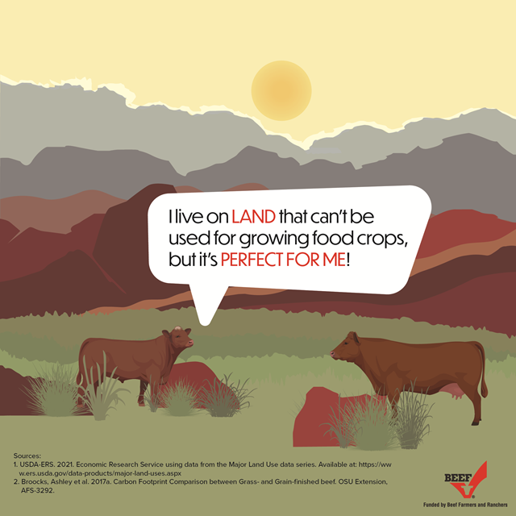
Approximately 29% of the land in the United States is too wet, rocky, steep, or arid to support cultivated agriculture.² However, cattle graze on plants native to their surroundings that humans can’t eat. Their unique, four-compartment stomach and digestive system is home to trillions of microbes. These microbes allow cattle to benefit and gain nutritional value from these sources that other animals can’t digest.

Slide 2
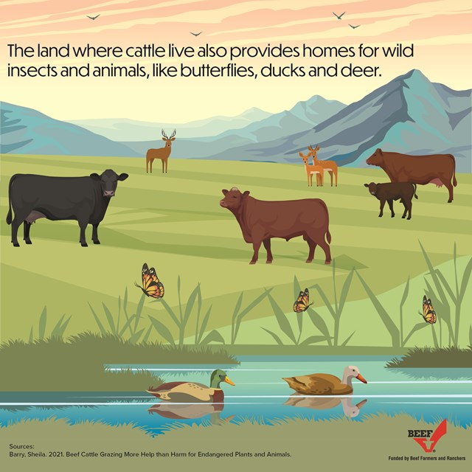
By using byproducts that would otherwise go to waste, cattle are enhancing the sustainability of other industries. For example, cattle eat distillers grains from the corn ethanol industry, cottonseed that is a byproduct of cotton production, and beet pulp that is a byproduct of sugar beet production.

Slide 3
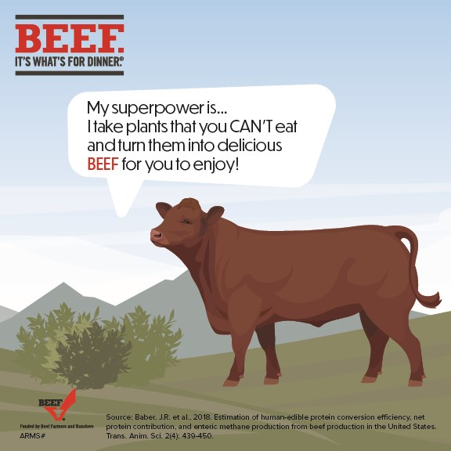
About 90% of what cattle eat can’t be digested by humans, making them invaluable to a sustainable food system. Cattle consume plants that humans can’t eat and through their unique digestive system, transform these plants into a high-quality, nutrient-rich protein. In addition to the grasses they graze on for most of their lives, cattle can eat numerous other food byproducts. They can take items like brewers’ grains, pea pulp, beet tops, and potato peelings and turn those products into beef.

Slide 4
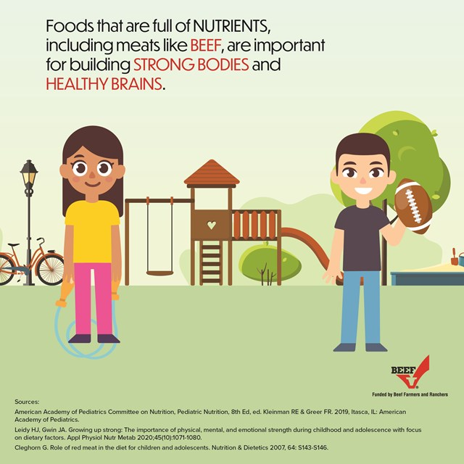

Slide 5
